Slide 1


Slide 2
Mine water risk in open pit slope stability

Slide 3
Introduction
Slope stability analysis plays an integral role in the design of various mining applications including waste dumps, heap leach piles, solution ponds, and tailings dams. Generally, limit equilibrium analysis using one of the several prevalent approaches is considered adequate.

Slide 4
The density, saturation, and shear strength parameters of the materials forming the slope affect the failure mode and the calculated factor of safety (FS) against sliding. These parameters are generally based on laboratory tests. Field practices and construction procedures are often not completely simulated in the laboratory for various reasons.

Slide 5
Causes of slope failure
1. Gravitational force
2. Force due of seepage of Water
3. Erosion of the surface of the slopes due to flowing water
4. The sudden lowering of water due to a slope
5. Forces due to earthquakes.

Slide 6
Objectives
1. Finding endangered areas with respect to the ground water table.
2. Designing of optimal slopes with regard to safety, reliability and economics.
3. Finding level of drainage system required in mine.

Slide 7
Background
1. The project area selected is
lumpy chromite mine of M/s Jindal Stainless Ltd.The mine is situated in Orissa state of India.
2. The most likely geo-mining condition of the mine will be the water table up to 135 mRL depth because the water table will be most likely below this level with proper drainage and mining itself.

Slide 8
Background cont.
3. If the slope is not provided with the proper drainage i.e. the slope mass is in undrained condition then the water table may rise to 150 mRL.
4. The average rainfall in the area is about 900 mm/ annum. About 90% of the precipitation in the valley escapes as surface run off so there is negligible effect of rain water on the FOS.

Slide 9
Scope of analysis
1. The above objectives could only be reached if acted upon with a planned approach. The first step towards a goal always starts with knowing everything about it.
2. Thus I began with the literature review. The books, journals, papers proved a rich source of knowledge in this regard and were thoroughly studied and learned.
3. This was followed by collection of the data and then input this data into the slope/w software to find out the various FOS for various ground water level present there.

Slide 10
The role of water in slope stability
1. Addition of water from rainfall adds weight to the slope. Weight is force, and force is stress divided by area, so the stress increases and this can lead t o slope instability.
2. Water has the ability to change the angle of repose (the slope angle which is the stable angle for the slope).
3. 3. Water can dissolve the mineral cements that hold grains together. If the cement is made of calcite, gypsum, or halite, all of which are very soluble in water, water entering the soil can dissolve this cement and thus reduce the cohesion between the mineral grains.

Slide 11
Continue...
4. Groundwater exists nearly everywhere beneath the surface of the earth. It is water that fills the pore spaces between grains in rock or soil or fills fractures in the rock. The water table is the surface that separates the saturated zone below, wherein all pore space is filled with water from the unsaturated zone above. Changes in the level of the water table occur due changes in rainfall. The water table tends to rise during wet seasons when more water infiltrates into the system, and falls during dry seasons when less water infiltrates. Such changes in the level of the water table can have effects on the factors (1 through 3) discussed above.

Slide 12
Flow chart

Slide 13
Literature review

Slide 14
Mine water problem in open pit slope stability
It has been recognised that the most important factor which is tending to produce the movement of stable and unstable open pit slope is high water table, e.g. high pore pressure ratio above slip surface (Enver h. mandzic, 1992).

Slide 15
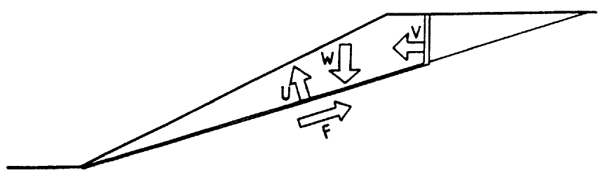
General aspect of mine water influence on slope stability
Water pressure which reduces the shearing strength.(force F).
Water pressure as an uplift force along the failure surface.(force U).
Water pressure in tension crack(force V)

Slide 16
Method for pit slope stability assesment
Limit equilibrium analyses of the rock slopes were performed with SLOPE/W program. This program provides an estimate for the factor of safety.

Slide 17
Limit equilibrium principles
All limit equilibrium methods utilise the Mohr‐Coulomb expression to determine the shear strength along the sliding surface.
The shear stress at which a soil fails in shear is defined as the shear strength of the soil.

Slide 18


Shear strength (available):
Shear stress (mobilised):
Where,
a = attraction,
c’ = cohesion,
φ’ = friction angle respectively in effective stress terms,
and F = factor of safety (FOS).

Slide 19

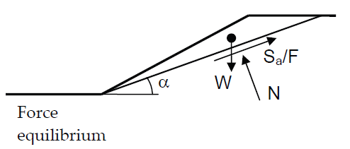

Slide 20
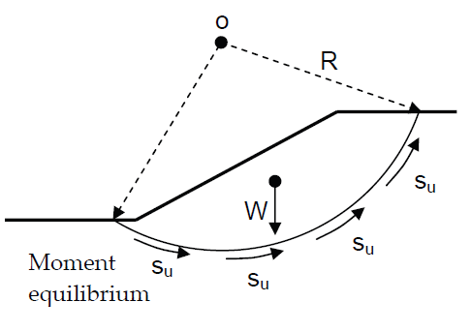

Slide 21
Methods that use limit equilibrium principle
Methods
1.Ordinary
2.Bishop simplified
3.Janbu simplified
4.Janbu GPS
5.Morgenst. - Price

Slide 22
Difference between all 5 methods
All LE methods are based on certain assumptions for the inter slice normal (E) and shear (T) forces, and the basic difference among the methods is how these forces are determined or assumed.

Slide 23
Summary of LE methods (Abramson et at. 2002, Nash 1987)
Methods | Cir. Non cir M=0 F=0 | Assumptions for T and E
Ordinary | Yes - Yes - | Neglects both E and T
Bishop simplified | Yes * Yes ** | Considers E, but neglects T
Janbu simplified | * Yes - Yes | Considers E, but neglects T
Janbu GPS | Yes Yes *** Yes | Considers both E and T
Morgenst. - Price | Yes Yes Yes Yes | Defined by f(x), T = f(x).λ.E
* Can be used for both circular and non-circular failure surfaces,
** satisfies vertical force equilibrium for base normal force, and
*** satisfies moment equilibrium for intermediate thin slices (Janbu 1957, Grande 1997).

Slide 24
Water problem in open cast mining
1.Open cast mining without relevant water problem
Frequently this is the case in the initial phases of many mining operations, or where the working is not too deep. The only water inflow come from superficial acquifers or from the weathered zone.

Slide 25
2. Open pit mining below piezometric line
In this category are mines with the problem of working under the piezometric level are combined with the problems of direct water inflow from rainfall or surface runoff common to all open pit mine. This involve installing slope drainage in order to improve stability condition. (Fernandez r rubio ,1986).

Slide 26
Factor of safety related to different slope condition ( Hoek and Bray,1981)
Factor of Safety | Details of Slope
<1.0 | Unsafe
1.0-1.25 | Questionable safety
1.25-1.4 | Satisfactory for routine cuts and fills, Questionable for dams
>1.4 | Satisfactory for dams

Slide 27
Study area
The study area selected for the project work is lumpy chromite mine of M/s Jindal Stainless Ltd.
The mine is situated in Orissa state of India. The strike length of the quarry will be 320 m.
The ore body is about 10 m wide.
The Cr2O3 is about 35%.
The mine is being developed to produce 40,000 tonne of ore with 6.5 lakhs m3 OB.
The life of the mine is 10 years.

Slide 28
Geo-Technical properties of study area
Lithology | Density (KN/m³) | Cohesion (kPa) | Friction angle (degree)
Talus material | 14.6 | 68 | 25
Quartzite | 25.8 | 228 | 27
Hard serpentinite | 21.6 | 193 | 28
Soft serpentinite | 16.0 | 101 | 26

Slide 29
Dimension & Characterization of ultimate pit slope in the study area
The southern slopes are characterized by quartzite and hard Serpentinite.
The RL of the upper part of the southern slope is 280 m RL.
The pit bottom has been fixed at 120 m RL. So, the pit is designed for an ultimate depth of 160 m.

Slide 30
There are three condition analysed
1. The water table is below the pit bottom that is no piezometric line included in analysis (dry condition).
2. The water table up to 135 m RL depth with proper drainage and mining (drained condition).
3. The water table up to 150 m RL if there is improper drainage and mining (undrained condition).

Slide 31
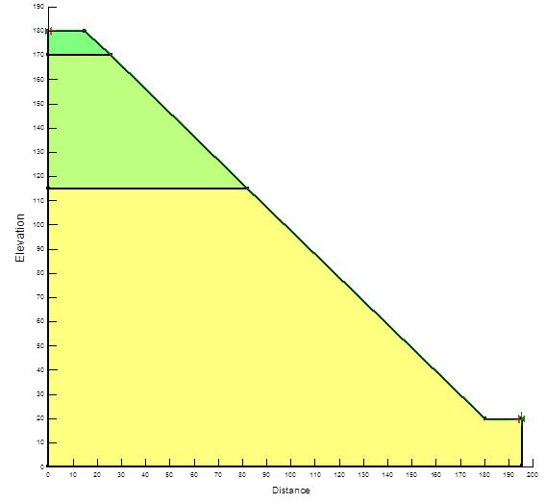
CASE-1: DRY SLOPE
legend
Talus material
Quartzite
Hard serpentinite
Figure: The water table is below the pit bottom that is no piezometric line included in analysis

Slide 32
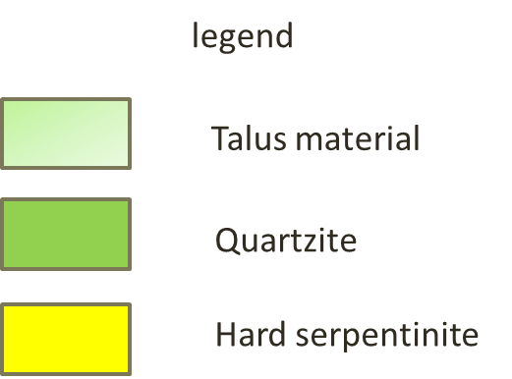
FOS=1.277

Slide 33
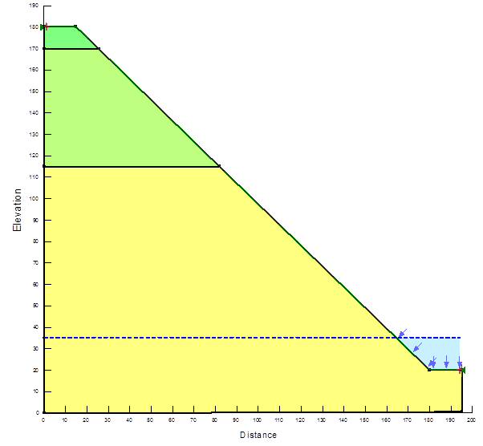

CASE-2 DRAINED CONDITION
Figure:5.3 Model of drained condition, piezometric line at 135 m RL

Slide 34

FOS=1.246

Slide 35

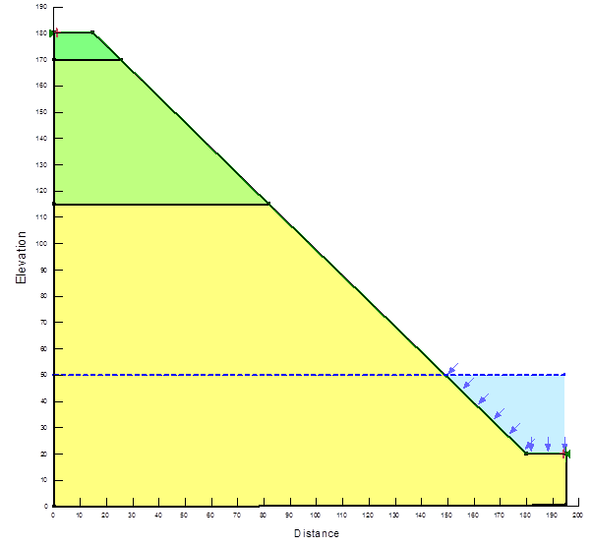
CASE-3 UNDRAINED CONDITION
Figure: Model of undrained condition, piezometric line at 150 m RL

Slide 36

FOS=1.230

Slide 37
Result and Discussion
Condition | FOS | Method
1. Dry slope | 1.227 | Janbu method
2. Drained condition | 1.246 | Janbu method
3. Undrained condition | 1.230 | Janbu method

Slide 38
The stability analysis was done by GEO SLOPE(SLOPE/W) computer programme, which is based on limit equilibrium method. A cut-off value of 1.25 safety factor was selected for pit slope stability analysis on the basis of the long term stability (Hoek and Bray, 1981).
In the dry slope there is no problem of slope failure because FOS is coming more then 1.25.
In the drained condition FOS is about 1.25 so the drained condition is also stable in term of slope failure.
But in the undrained condition the FOS is coming 1.23 so slope failure may occur in this condition.

Slide 39
Conclusions and Recommendations
1. This study concluded that the 160 m high southern slopes of the open pit mine with overall slope angle of 44 are valid with well developed drainage system and slope monitoring.
2. The FOS of the southern slope is decreases from condition 1 to condition 3.
3. It indicated that proper mine drainage system and proper mine plan should be prepare for stability of the slope in Sukinda mine for a optimum slope of 440.

Slide 40
References
1. Bieniawski, Z.T. (1984), “Input Parameters in Mining”, Rock Mechanics Design in Mining and Tunneling, A.A. Balkema, Netherland, Edition-8, pp.55-92.
2. Call, R. D. & Savely, J. P. (1990), “Open Pit Rock Mechanics”, In Surface Mining, 2nd Edition (ed. B. A. Kennedy), Society for Mining, Metallurgy and Exploration, Inc., pp. 860-882.
3. Call, R. D., Nicholas, D.E. & Savely, J.P. (1976), “Aitik Slope Stability Study”, Pincock, Allen & Holt, Inc. Report to Boliden Aktiebolag, Gallivare, Sweden.
4. Enver H. MANDZIC, ‘Mine water risk in open pit slope stability’, mine water and environment, vol 11, no.4, dec. 1992, pp 35-42
5. GEO-SLOPE International Ltd. (2002) SLOPE/W User’s guide for Slope Stability Analysis. Version 5., Calgary, Alta., Canada.
6. GEO-SLOPE International Ltd. (2002) VADOSE/W User’s guide for finite element seepage analysis. Version 5., Calgary, Alta., Canada
7. Hoek, E. (1970), “Estimating the Stability of Excavated Slopes in Opencast Mines”, Trans. Instn. Min. Metall. (Sect. A: Min. industry), 79, pp. A109-A132.

Slide 41
8. Mandzic, EH, Rainwater inflow influence on open pit rock slope activities, Proc. Of 31st U.S Symposium, rock mechanics constribution and challinges, Golden USA, pp 737-742 (1990).
9. Mandzic, EH, Stability of unstable final slope in deep iron mine, Proc. Of 5th Int. Symp. On landslide, Lausanne, pp 455-459 (1988).
10. Fernandez r rubio, ‘water problem in Spanish coal mining’ international journal of mine water, vol. 5 (3), pp 13-28, (1986)
11. V.K Singh, Slope Stability Division, Central Mining Research Institute (CMRI), “Slope Design of a Lumpy Chromite Ore Mine, Sukinda, Orissa, India” (2005).

